Slide 1
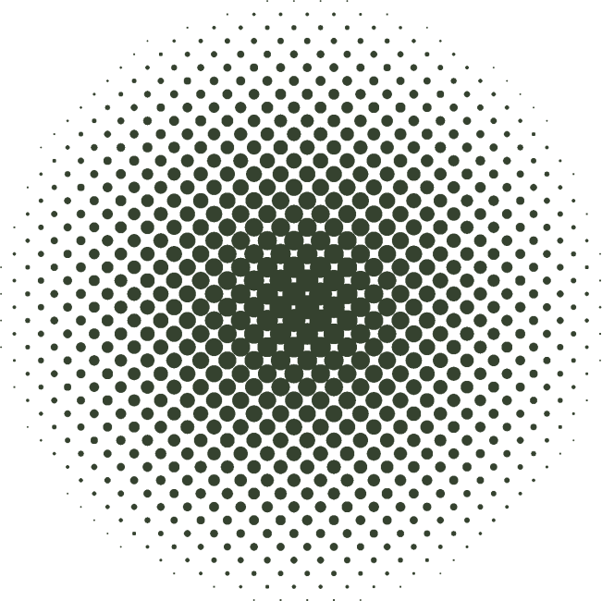
PROJECT PRESENTATION
Presented by Vault 107 (Group 4)

Slide 2
Overview
1
2
3
4
5
Problem
Solution
Title
PACT Framework
Figma Layout

Slide 3
1
Problem
Overlooking payment due dates
Increased risk of forgetting payments
Potential consequences of missed payments:
Late fees
Service disconnection
Extra charges incurred for overdue bills
Inconvenience caused by last-minute payments

Slide 4
2
Solution
Creating an app that helps people/users to be reminded of the bill’s due like a a note that specifically remind user about their dues in payments.
TimelyPay can help users avoid overlooking payment due dates, reduce the risk of missed payments, and mitigate the potential consequences associated with late payments.

Slide 5
3
Title
TimelyPay: A Payment Reminder Application for Payments

Slide 6

4
PACT Framework
Users with timely payment dues.
Club members with monthly payment.
Users who want to manage their bills.
1
People
Adding record of Payment
Includes adding name and date of due.
Can swipe to remove reminders.
2
Activities

Slide 7
4
PACT Framework
Can be interactive on different screen sizes.
Can be use in public place
It is an offline application.
Can only be use in mobile phones (android)
Can not be use as a payment gateway
3
Context
Flutter Framework
VScode
Dartpad
4
Technology

Slide 8
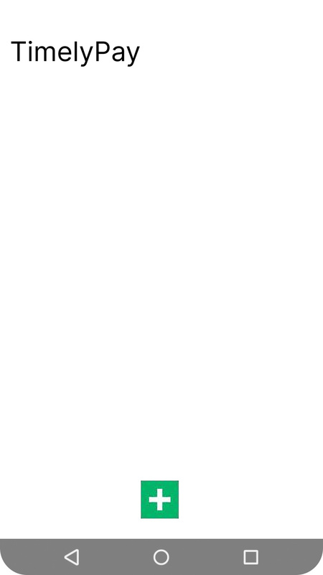
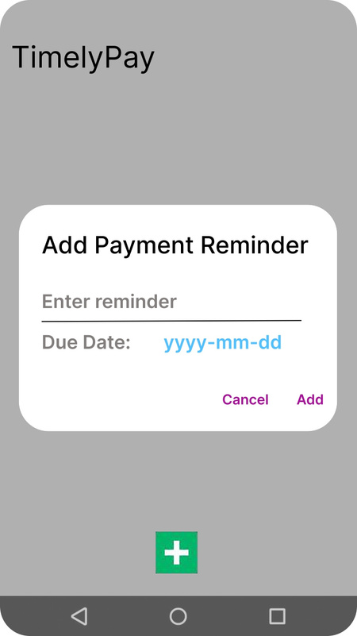
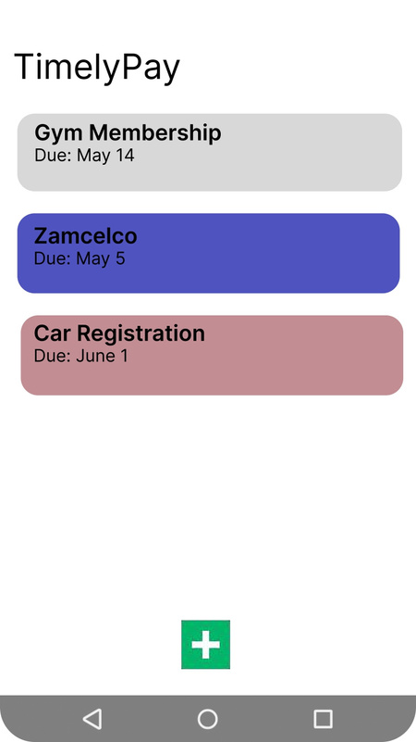
5
Figma Layout

Slide 9
THANK YOU!

